Slide 1

THE LANGUAGE OF SPOKESPERON EYES: ENHANCING BRAND CONNECTION THROUGH EYE GAZE
Jasmina Ilicic, Monash University, Australia
Stacey Baxter, University of Newcastle, Australia
Consumer Brand Relationship Conference, 20 May, 2019

Slide 2

PURPOSE
Human brands strategically manage their image
Social media is a tool celebrities can use to manage their brand
  Images are staged/produced to manage perceptions
  Authentic images increase attachment
  Do the facial characteristics of a human brand influence self-human brand connection?

Slide 3

CONSUMER-BRAND
CONNECTION
Consumers form parasocial relationships with human brands
  Non-verbal cues are important in forming relationships with human brands (Horton and Wohl, 1975)
    Appearance
    Gestures
    Voice
  Research is yet to examine the effect of eye gaze on human brand connection.

Slide 4

EYE GAZE AND
CONNECTION
Eye gaze plays a significant role in human relationships
Eye gaze used to judge the behavioral intentions of others
  Approach (friend)
  Avoid (foe)
Direct eye gaze can express intimacy, friendliness, warmth
Direct eye gaze enhances perceptions of trustworthiness

Slide 5


STUDY 1
What effect does eye gaze have on self-human brand connection?
N = 151 (79 male, 72 female, Mage = 41.69)
Between subjects design: two conditions
Measures
  Familiarity (extremely unfamiliar – extremely familiar)
  Liking (very unlikeable – very likable)
  Self-human brand connection (Escalas and Bettman, 2005)

Slide 6
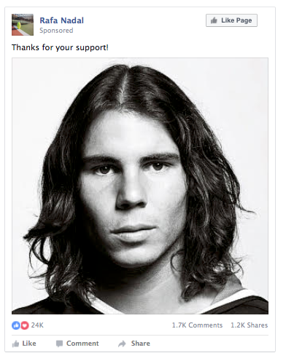
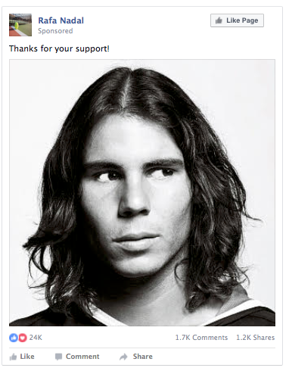
STUDY 2
Does brand warmth explain the effect of eye gaze on self-human brand connection?
N = 160 (72 male, 88 female, Mage = 35.35)
Between subjects design: two conditions
Measures
  Familiarity and Liking
  Self-human brand connection (Escalas and Bettman, 2005)
  Brand warmth (Wang, Mao, Li and Liu, 2016)

Slide 7
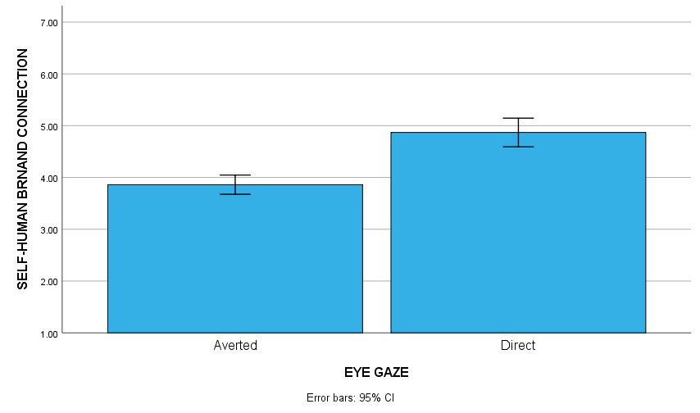
FINDINGS
Direct gaze enhances self-human brand connection (Study 1): p < .001
Brand warmth explains the effect direct gaze has on self-human brand connection (Study 2): β = .17, 95% CI = .04 to .33
Predictors: | Beta | t | p
Dependent Variable: Brand Warmth (Model 1)
Eye Gaze (X) | .95 | 4.59 | <.001
Dependent Variable: Self-Human brand Connection (Model 2)
Eye Gaze (X) | .33 | 1.71 | .088
Brand Warmth (M) | .18 | 2.65 | .008

Slide 8

IMPLICATIONS
Human brand should consider eye gaze if seeking to form or enhance connections with consumers
  Enhance perceptions of warmth
When producing social media posts select images with a direct eye gaze

